Slide 1

Radio Production:
Late Night Show
Chloe, Elise and Chris
Notes:
chris

Slide 2
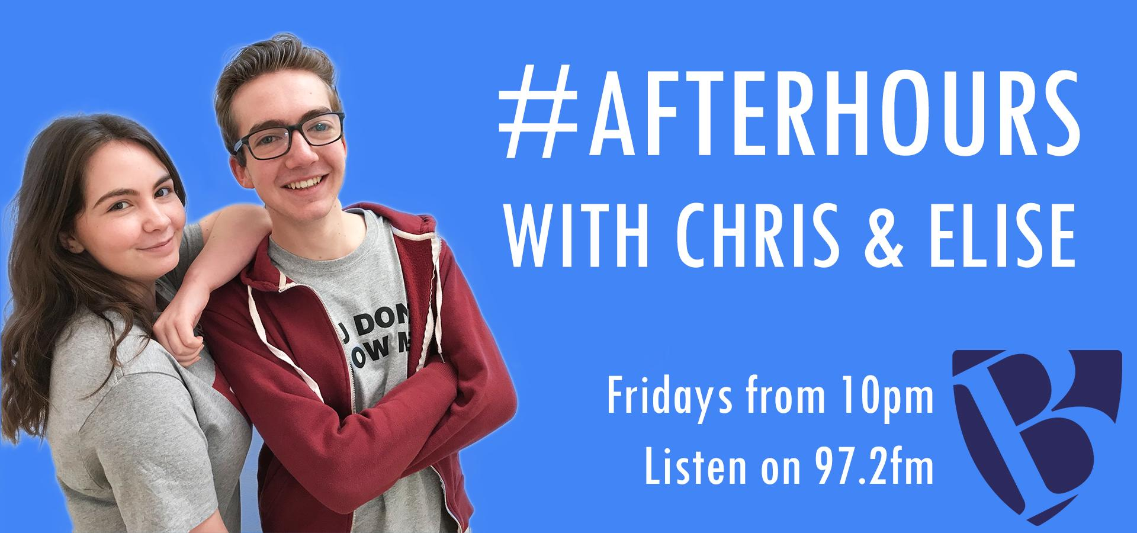
Notes:
chris

Slide 3

Target Audience
#AfterHours
The primary audience for Barnfield Radio is 15-21 year olds from Bedfordshire, they will be in the social group E, non gender and ethnic specific. Because of the social group they are in they will not have disposable income which is why the competition will work as it is something they might not be able to achieve on their own.
Secondary audience is 13-15 mainstreamers these people could also be aspirers who want to be like an older sibling who is in the primary audience so they listen to Barnfield Radio.
Tertiary audience people who have come back to study or people who want to hold on to their youth by listening to Barnfield Radio.
Notes:
elise

Slide 4
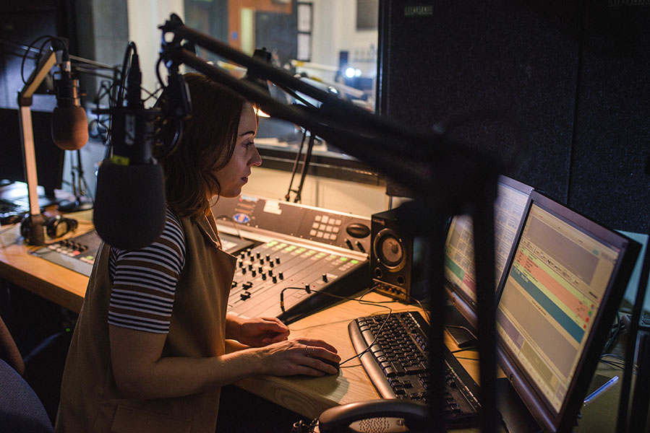
Demands of Barnfield Radio
#AfterHours
Broad range of music
Different engaging topics
On trend
“in the know” - up to date
Reason to listen
Notes:
chris

Slide 5

Draft Running Order
#AfterHours
22:00 - Introduction of presenters
22:01 - Play 2 songs
22:07 - Advert Break
22:09 - Talk about competition
22:10 - Play 3 songs
22:19 - Talk, News + Weather
22:22 - 2 songs
22:28 - Advert Break
22:30 - Quiz between presenters
22:35 - Play 2 songs
22:41 - Advert Break
22:43 - Competition Reminder
22:44 - Presenters Chat
22:46 - 2 songs
22:52 - Advert Break
22:53 - News + Safety Awareness
22: 56 - Goodbye from presenters
22: 57 - Final song
Notes:
chloe

Slide 6
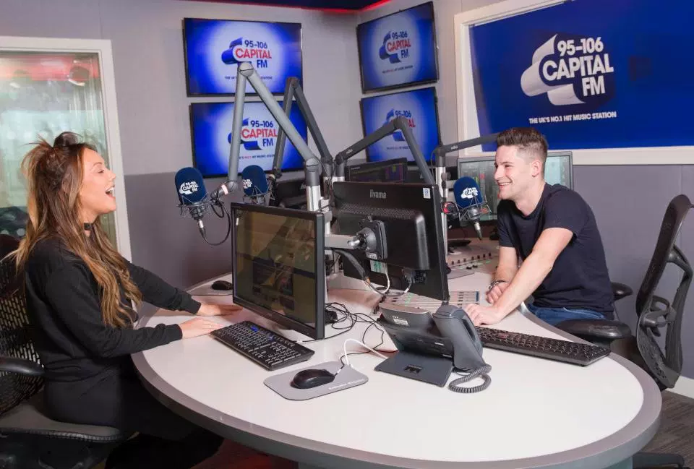
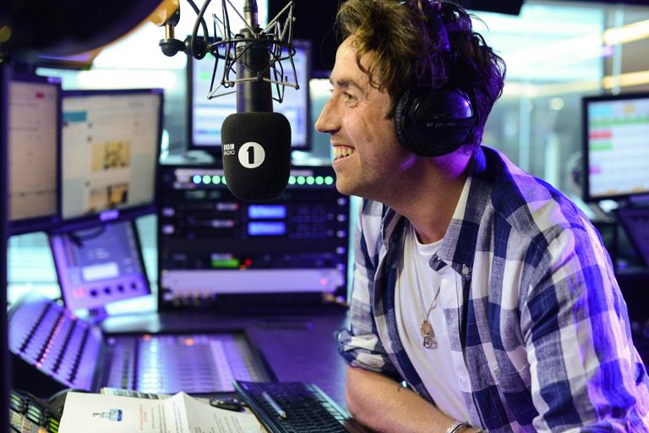
Presenter Styles
#AfterHours
In our show we want to be fun, upbeat we want to interact with the audience through social media
Let personalities shine through
Jokes between presenters
Notes:
elise

Slide 7


Ident Demands
#AfterHours
Barnfield Radio Ident
Show ID: Barnfield Radio After Hours
Sweeper: After Hours
In to ad: Shoutout about the show
Upbeat
Catchy, but not cringey
Broadcast the name
Notes:
chloe

Slide 8

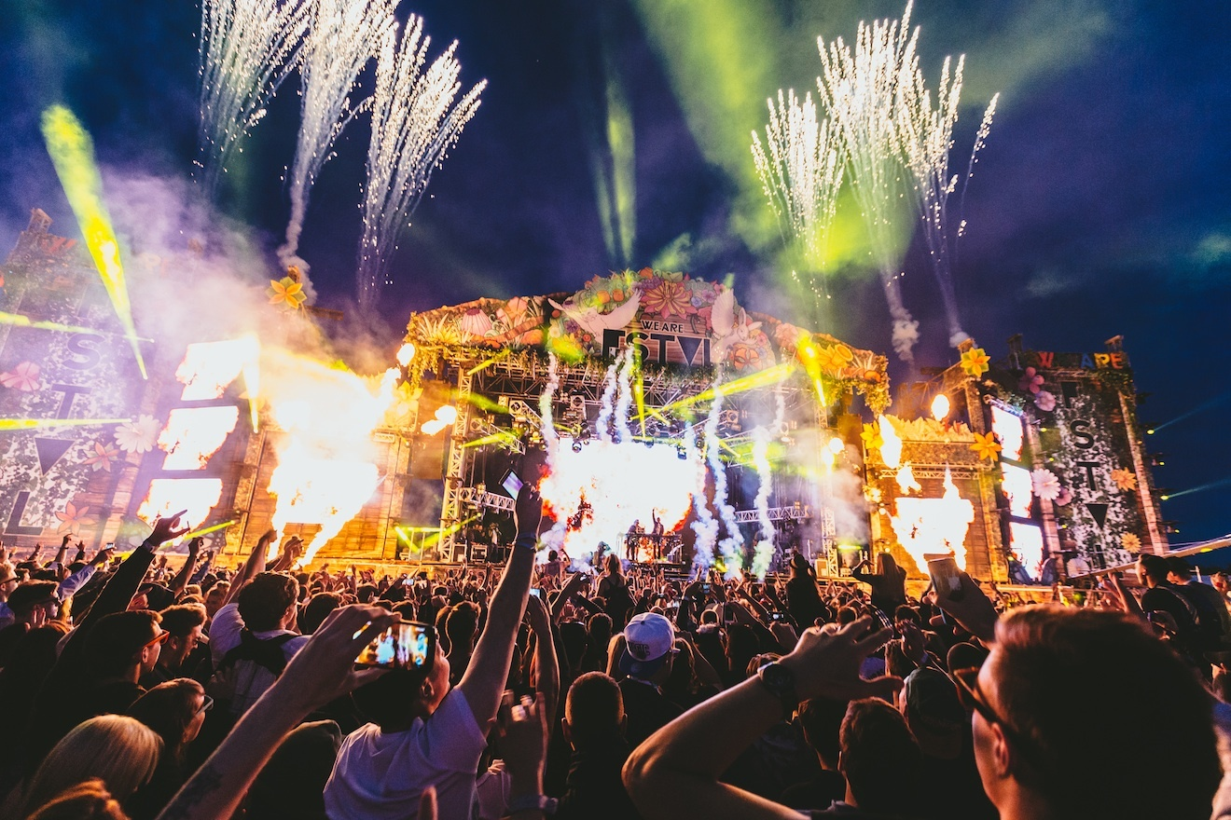
Audience Interactivity
#AfterHours
#AfterHours
Competitions
What people are up to
Calls
Twitter
Notes:
chloe

Slide 9
Mood Board
Notes:
chris

Slide 10

Notes:
chris

Slide 11
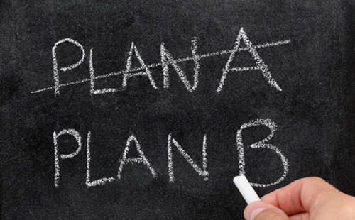
Contingency Plan
#AfterHours
Main presenters Chris & Elise
If either one of us is ill then Chloe the producer will take over.
If one of the presenters makes a mistake we can always re record as if we are not live.
Notes:
Elise

Slide 12
Any Questions?

